Slide 1



Nested DIO for Feature Selection
& Hyperparameter Optimization
Cross-Domain Validation: Medical Diagnostics → Computer Vision
Professor: Dr. Neggaz Nabil
Project on Github
Pesented by Bellatrache Mohamed Amine & Ghizlane Cherif Imane
USTO-MB | Computer Science | Data Science | Nov 2025

Slide 2
Outline
DIO Algorithm
Nested Optimization Framework
Medical Domain: Breast Cancer
Vision Domain: CIFAR-10
Conclusions

Slide 3
Introduction
Breast cancer is one of the deadliest diseases affecting women worldwide [2]
Machine learning shows promise, but faces real challenges:
- Medical datasets have 30+ features—which ones really matter?
- A model's success depends on both the features AND its settings
- Picking features first, then tuning later misses important connections
The old way: Choose features → Train model → Tune parameters
The problem: What if the best features change depending on the parameters?
•Our approach: Optimize both together using DIO [1]

Slide 4
DIO: History & Origins
•Created in 2025 by international researchers [1]:
Ali El Romeh
Seyedali Mirjalili
Václav Snášel
.
•Published in Cluster Computing (Springer)—a prestigious journal
• - DOI: 10.1007/s10586-025-05543-2
• - Peer-reviewed and rigorously tested
github

Slide 5
How DIO Works: The Hunting Strategies
Dholes use three hunting strategies:
Strategy 1: Chase the Leader
- Follow the best hunter toward the prey
- In optimization: Exploit the best solution found so far
Strategy 2: Try Random Directions
- Check what other pack members are discovering
- In optimization: Explore new areas of the search space
Strategy 3: Stick with the Pack
- Move toward the group's center
- In optimization: Balance between extremes, avoid getting stuck
DIO translates dhole pack hunting into mathematics

Slide 6
How DIO maps dhole behavior to algorithm:
Lead vocalizer → Best solution guides search (Eq. 5)
Vocal signals → V parameter controls exploration ↔ exploitation (Eq. 1) (Eq. 2)
Cooperative hunting → Pack moves cooperatively (avoid traps) (Eq. 3) (Eq. 4)
Territorial instincts → Boundary constraints (stay in valid zone) (Eq. 6)
Pack hierarchy → Dynamic leadership updates (Eq. 7)

Slide 7
DIO: The Math Behind It
A. Vocalization Influence (Eq. 1)
B. Movement Scaling Factor (Eq. 2)
V(t) = 2 - (2*t / MaxIter)
B = V × r
D. Distance to Lead Vocalizer (Eq. 4)
C. Sinusoidal Oscillation (Eq. 3)
D_lead = |C × (LeadVocalizer_pos)² - (dhole)²|
C = r + sin(r × π)
F. Boundary Constraints (Eq. 6)
E. Position Update (Eq. 5)
If D_i < lower_bound OR D_i > upper_bound: D_i = lower_bound + (upper_bound - lower_bound) × rand()
X_new = LeadVocalizer_pos +B × √(D_lead)
G. Lead Vocalizer Update (Eq. 7)
If fitness(D_i) > fitness(LeadVocalizer): LeadVocalizer = D_i

Slide 8
DIO Algorithm: Pseudocode
1. Initialize population D with random positions
2. Evaluate fitness of each dhole in D
3. Set lead_vocalizer = dhole with best fitness
4. For t = 1 to Max_iter do:
a. Calculate V using Eq. 1: V = 2 - (2 × t) / Max_iter
b. Determine phase (0 = exploration, 1 = exploitation)
c. For each dhole D_i in D do:
If phase == 0 (exploration):
If rand() < 0.5:
D_i = lb + rand(1, dim) × (ub - lb)
Else:
Calculate B (Eq. 2) and
Calculate D_lead (Eq. 4)
Update position using X_lead (Eq. 5)

Slide 9
else: # phase == 1
Calculate B (Eq. 2) and
Calculate D_lead (Eq. 4)
Update position using X_lead (Eq. 5)
iii. Apply boundary check for D_i (Eq. 6)
"Est-ce que ce dhole est sorti du territoire ?
iv. Evaluate fitness of D_i
v. If fitness(D_i) < fitness(lead_vocalizer):
lead_vocalizer = D_i
5. Return position of lead_vocalizer as best solution

Slide 10
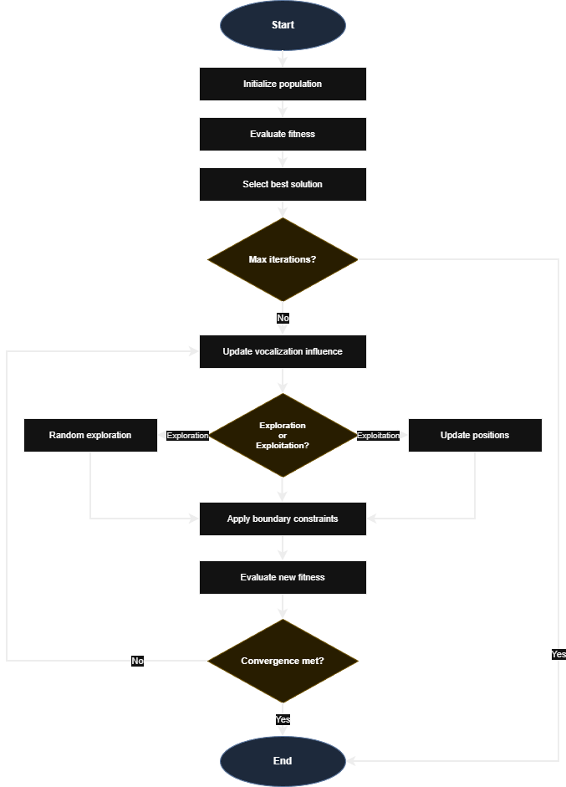
DIO Algorithm Flowchart [1]

Slide 11
DIO vs. State-of-the-Art Benchmark Comparaison [1]
•Tested on CEC2017—the gold standard for optimization algorithms
• - 29 different test functions (unimodal, multimodal, hybrid, composite)
• - Industry standard for comparing metaheuristics
•
•Compared against famous algorithms:
• - PSO (Particle Swarm Optimization)—inspired by bird flocking
• - GWO (Grey Wolf Optimizer)—inspired by wolf hunting
• - WOA (Whale Optimization Algorithm)—inspired by whale hunting
• - MFO (Moth-Flame Optimization)
• - ALO (Ant Lion Optimizer)
•
•Results speak for themselves:
• - DIO ranked 1st or 2nd on 22 out of 29 functions (22/29 )
• - Beats PSO and GWO consistently on complex problems
• - Particularly strong at avoiding local optima traps
•Bottom line: DIO is competitive with—and often better than—established algorithms

Slide 12
What Can You Use DIO For?
Engineering & Design
•- Structural optimization (designing bridges, aircraft parts)
• - Resource allocation in factories
Machine learning
• - Selecting which features to use from high-dimensional data
• - Tuning hyperparameters for better model performance
• - Neural architecture search for deep learning
Other interesting domains:
•- Financial portfolio optimization (maximizing returns, minimizing risk)
• - Energy grid management (balancing supply and demand)
• - Logistics and delivery route planning

Slide 13
Nested Optimization Framework
Outer Loop: Hyperparameters (θ)
→ n_estimators, max_depth, learning_rate, ...
Inner Loop: Feature Selection (S) for each θ
→ Binary mask over D features
Fitness: F = 0.99 × (1 - Acc) + 0.01 × (|S|/D)
Total evals = (pop_out × iter_out) × (pop_in × iter_in)

Slide 14
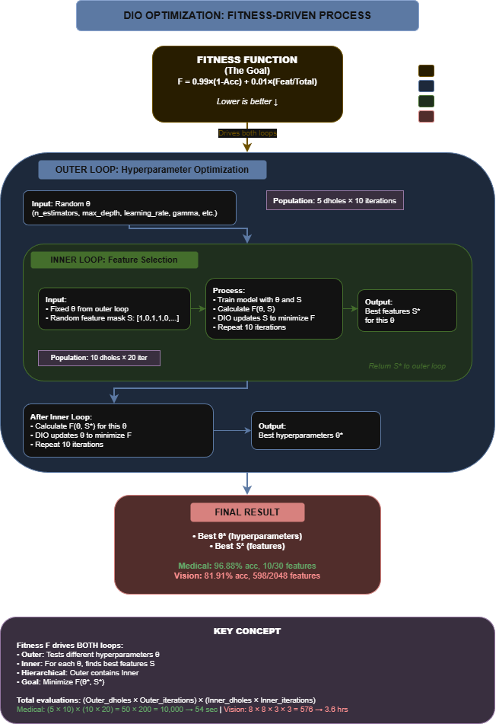
Two-level optimization Methodology: Outer loop (hyperparameters) + Inner loop (features)

Slide 15
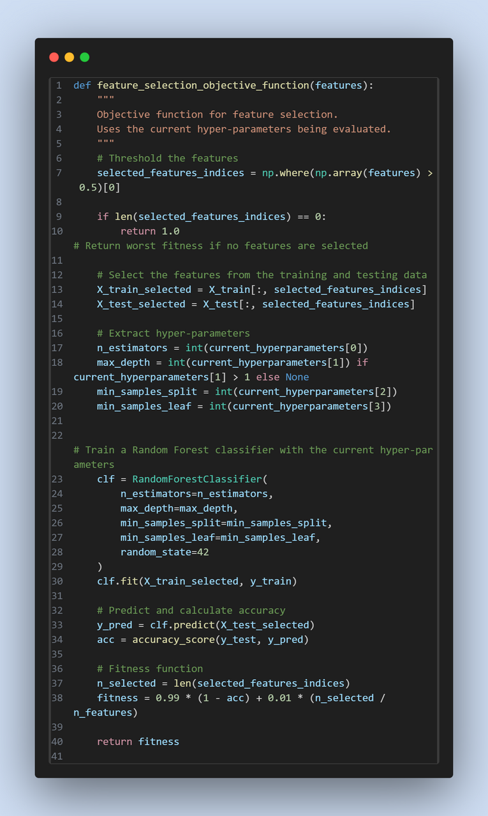
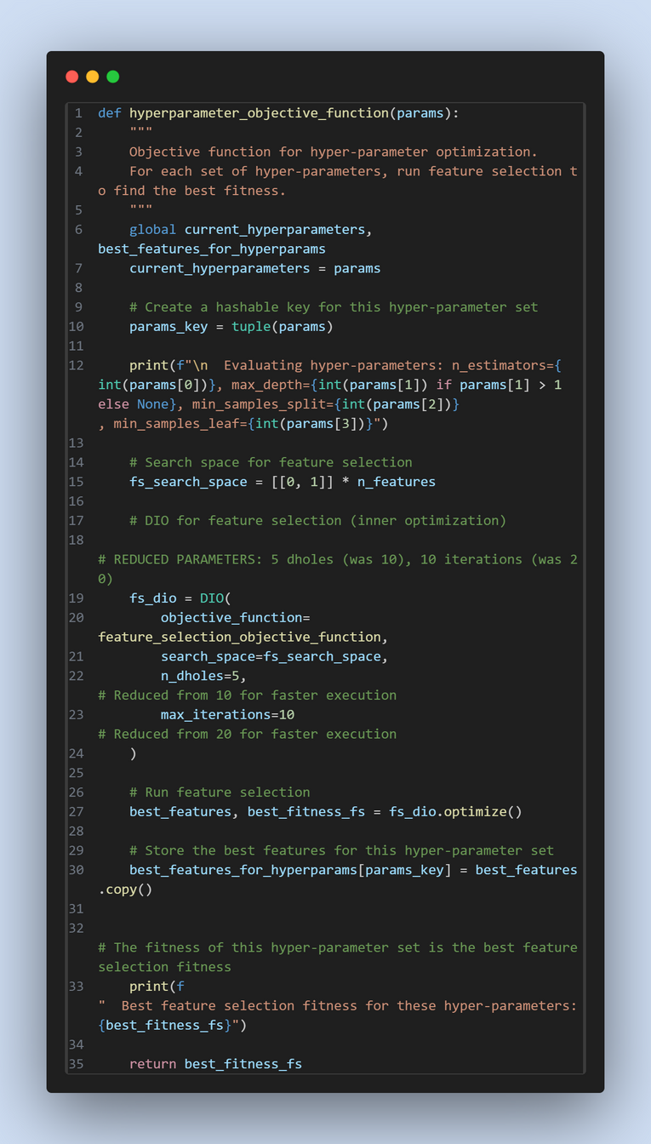
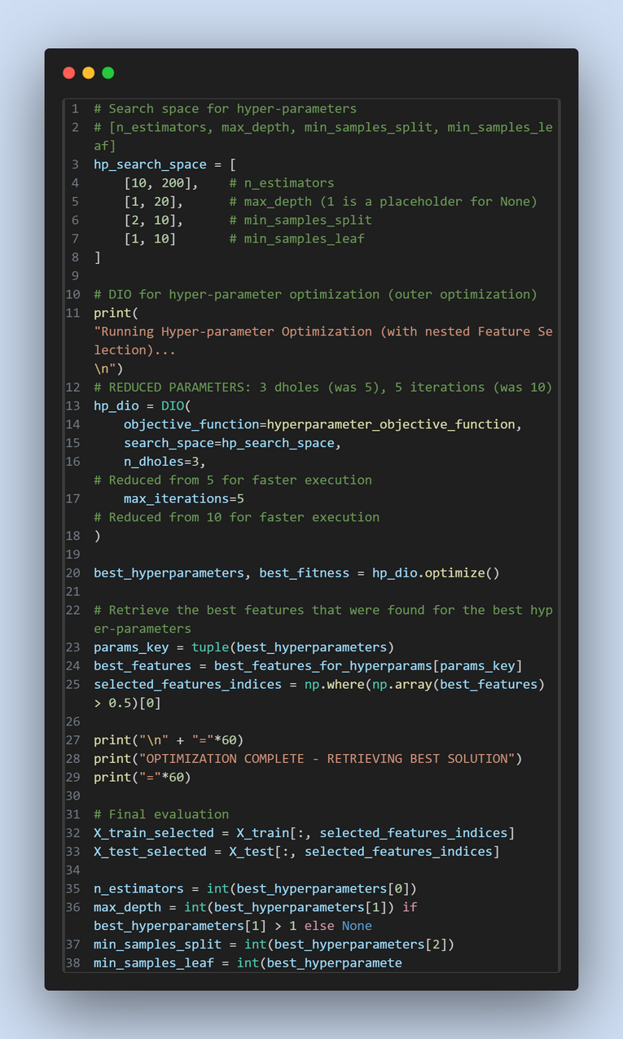
Inner Loop: Feature Selection Objective Func RF
Outer Loop: Hyperparameter Selection Objective Func RF
running optimization and retreiving results

Slide 16
Medical Domain: Breast Cancer Dataset
Wisconsin Dataset [2]: 569 samples, 30 features
Validation: 30 independent runs
Statistical test: Wilcoxon signed-rank
Three approaches compared:
Approach 1: RF + Single-Split
Approach 2: RF + 5-Fold CV
Approach 3: XGBoost + Single-Split

Slide 17
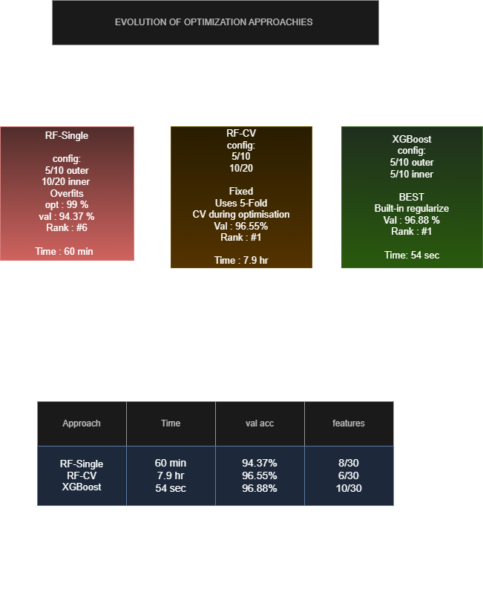
Research Evolution
Evolution from RF Single-Split (failed) → RF-CV (fixed) → XGBoost (best)

Slide 18
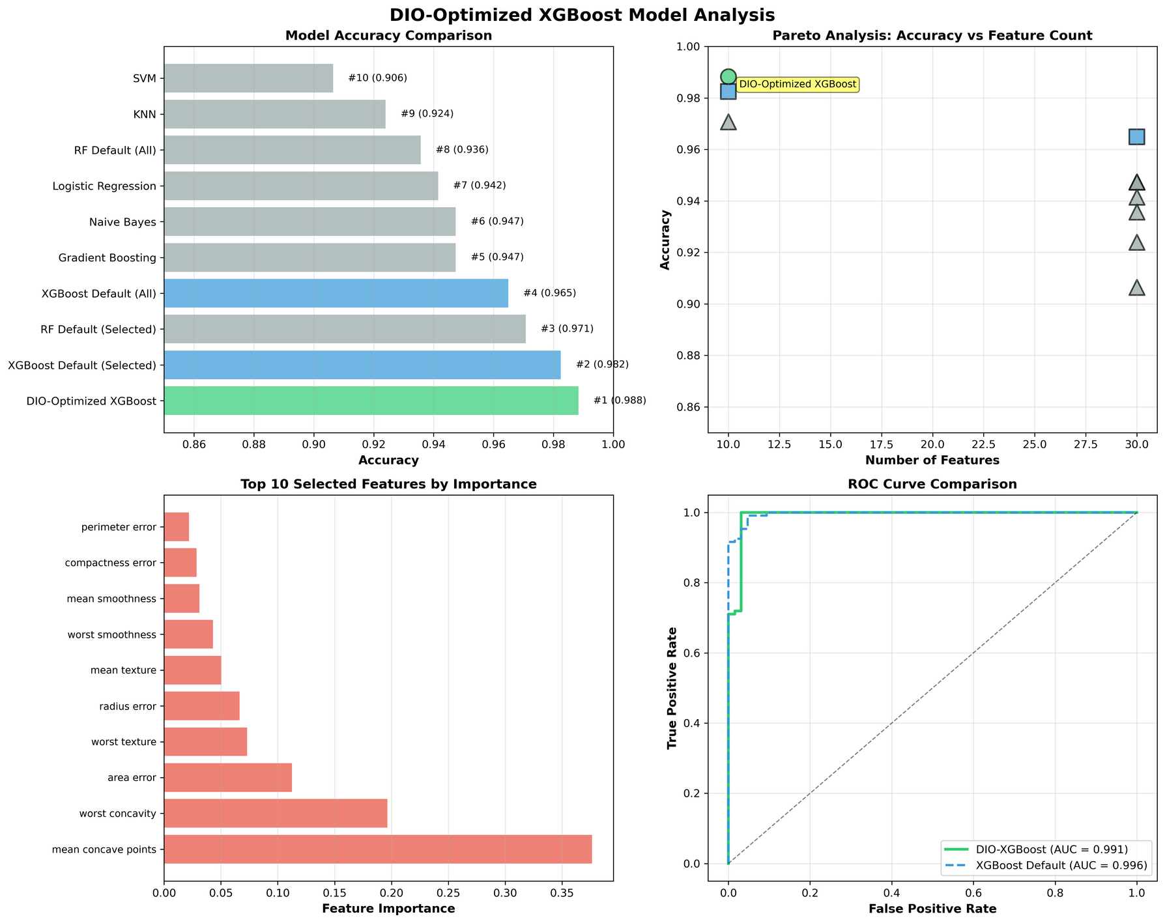
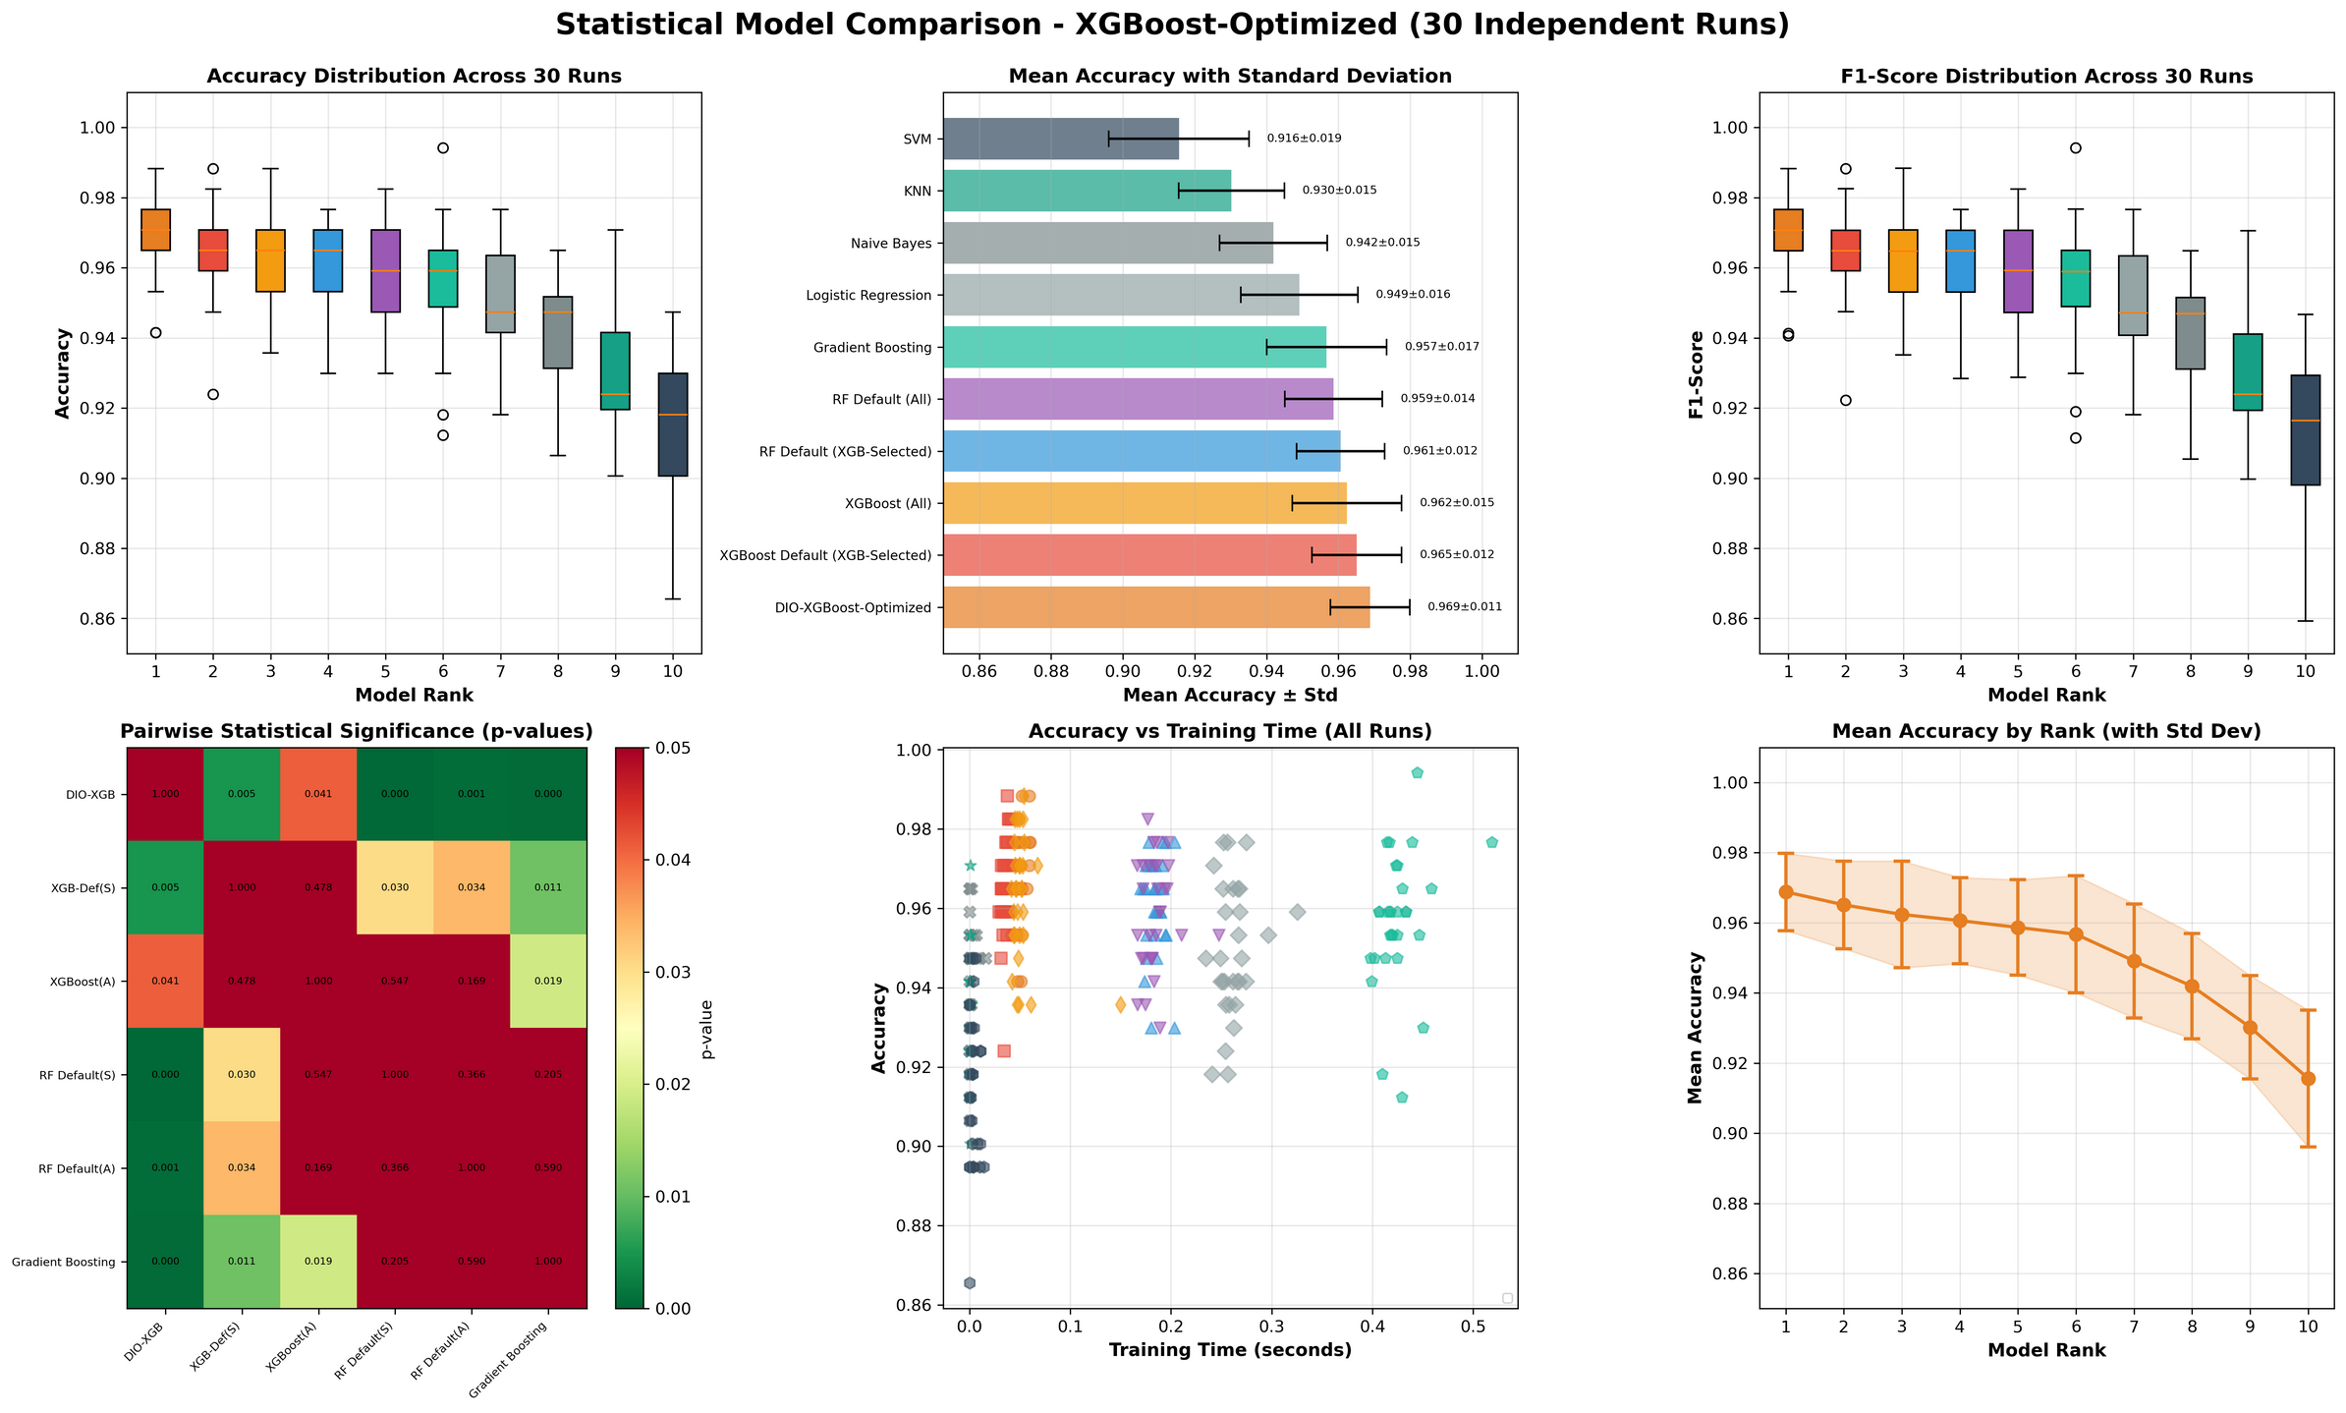
XGBoost - Best approach results
Surprising finding:
XGBoost didn't need cross-validation during optimization!
Single-split worked fine (inherent regularization prevented overfitting)
Algorithm choice matters for optimization strategy
Single run model comparaison (XGBoost)
(30 run) Statistical comparaison (XGBoost)

Slide 19
Medical Domain: Results
❌ RF Single-Split: 94.37% ± 2.1% (Rank #6)
→ p = 0.89 vs default (not significant)
✓ RF + CV: 96.55% ± 1.5% (Rank #1)
→ p = 0.031* vs default | 80% fewer features
🏆 XGBoost: 96.88% ± 1.2% (Rank #1)
→ p = 0.0426* vs default | 67% fewer features
* Wilcoxon signed-rank, 30 runs, α=0.05

Slide 20
Statistical Rigor: Wilcoxon Signed-Rank Test [7]
30 runs give us averages—but are differences real or just luck?
Wilcoxon Signed-Rank Test:
Non-parametric test (doesn't assume normal distributions)
Compares paired samples (same data splits for fairness)
Null hypothesis: 'No real difference between methods'
Results for DIO-RF-CV vs DIO-RF-Single:
p < 0.001 (***) → Cross-validation dramatically better
Confirms CV is essential for RF optimization
Significance levels:
* p < 0.05 (significant)
** p < 0.01 (very significant)
*** p < 0.001 (extremely significant)
ns = not significant (could be chance)
Results for DIO-XGBoost vs baselines:
vs XGBoost Default: p = 0.0411 (*) → Significant improvement
Mean difference: +1.60% accuracy
vs RF Default: p < 0.001 (***) → Highly significant improvement

Slide 21
Vision Domain: CIFAR-10 [3]
Used ResNet50 [4] (pretrained on ImageNet) to extract features
Converted images → 2048-dimensional feature vectors (68× medical)
Computational subset: 2,500 images (2000 train, 500 test)
Applied DIO-XGBoost optimization
Budget: 3/8 both loops → 576 evals (vs 10K medical)
Optimization time: 3.6 hours
30-run validation (Wilcoxon):
DIO-XGBoost: 81.91% ± 1.38%
XGB Default: 83.27% ± 1.25%
p = 7.15×10⁻⁵ *** → DIO significantly WORSE
Cause: Insufficient budget for 2048-D search space—even XGBoost can't overcome severe under-budgeting
•Single-run result: 83.0% vs 80.8% default (+2.2%)

Slide 22
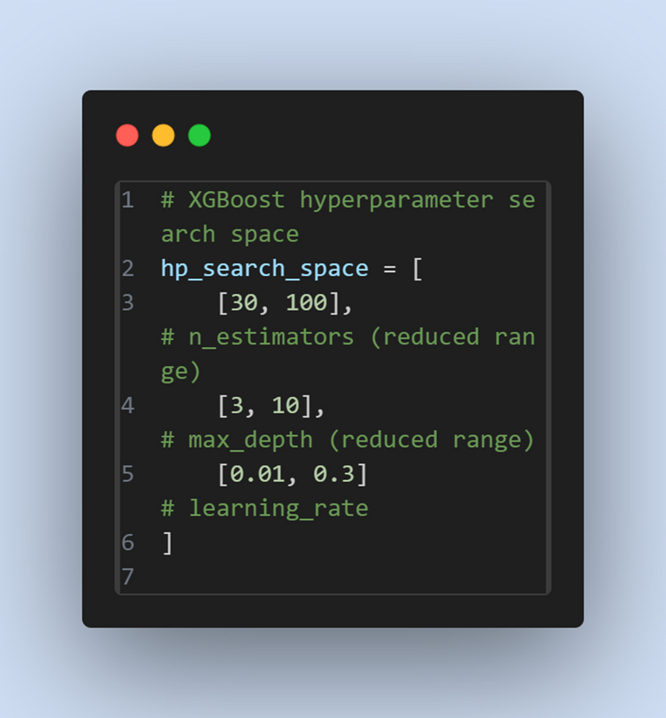
CIFAR-10 Search Space

Slide 23
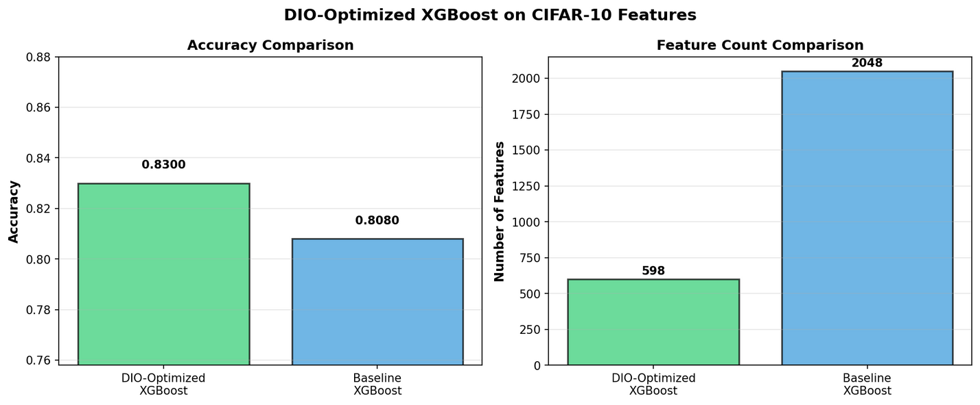
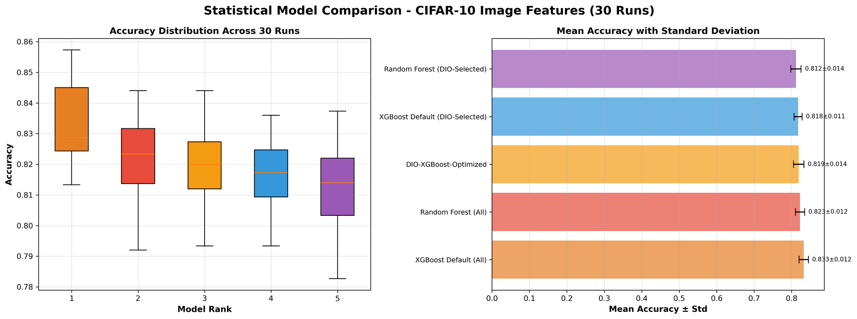
Single run model comparaison
(30 run) Statistical comparaison

Slide 24
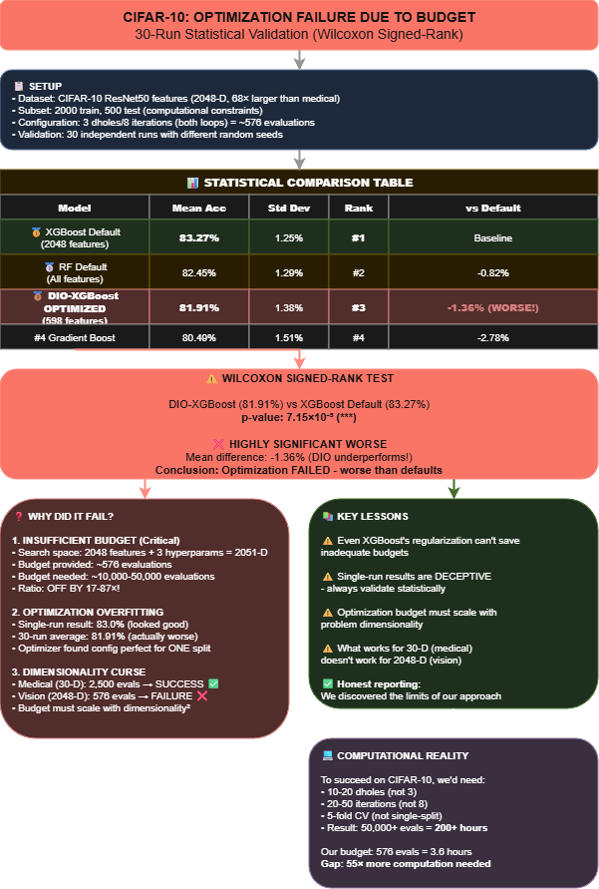
CIFAR-10: Statistical Analysis of Optimizataion Failure
30-run validation reveals DIO underperforms defaults: 81.91% vs 83.27% (p<0.0001)

Slide 25
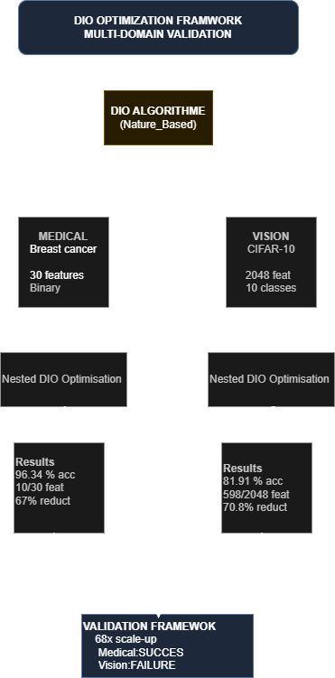
Cross-Domain Framework

Slide 26
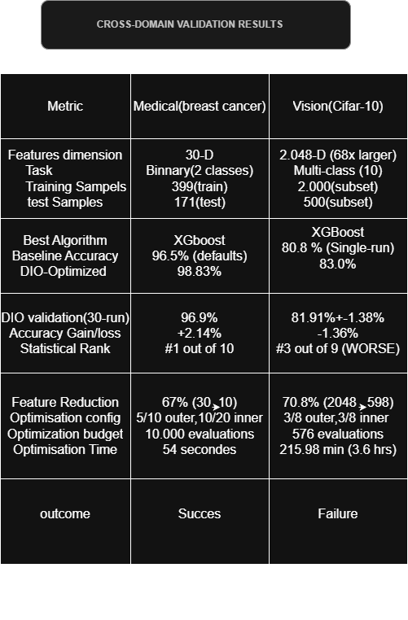
Results Summary
Complete comparison: Medical (96.9%, SUCCESS) vs CIFAR-10 (81.91%, FAILURE)

Slide 27
1. Optimization overfitting is real
RF single-split: p=0.89 (no gain vs default)
2. Algorithm choice determines CV need
Key Findings
RF+CV: p=0.031* | XGBoost: p=0.0426*
3. Budget must scale with dimensionality
Medical: p<0.05 ✓ | CIFAR: p=7.15×10⁻⁵ ✗
4. 30-run validation essential
Single-run can show +2.2% that vanishes

Slide 28
1. Adaptive Budget Allocation
Automatically adjust population size based on dimensionality
Develop formulas: budget ≈ k × D² (where D = dimensions)
Balance computational cost with quality
Future Research Directions
2. Hybrid Optimization Strategies
Combine DIO (global search) with local refinement (Bayesian optimization)
Use DIO for exploration, gradient methods for exploitation
3. Broader Applications
Other medical tasks: multi-class diagnosis, survival prediction
Neural architecture search with DIO
Fairness-aware feature selection (removing biased features

Slide 29
For Healthcare ML Deployment:
🏆 DIO-XGBoost: 96.88%, 10 features
→ Best accuracy, use when resources available
✓ DIO-RF-CV: 96.55%, 6 features
→ Best interpretability, 80% cost reduction
Practical Recommendations
⚠ DIO-RF-Single: 94.37%, 8 features
→ Only for rapid prototyping
Golden Rules:
Always validate with 30+ runs
Use statistical tests (Wilcoxon)
Scale budget with dimensionality

Slide 30

DIO: Key Advantages
Superior convergence speed
Excellent exploration-exploitation balance
Outstanding local minima avoidance
Easy implementation

Slide 31
DIO: Key Limitations
Parameter sensitivity (population size, iterations)
High computational cost for large-scale problems
Variable performance across problem types

Slide 32
5. Conclusion: Key Contributions
1. Discovered 'Optimization Overfitting'
→ Use CV during optimization, not just evaluation
2. Algorithm-Dependent Strategies
→ RF needs CV; XGBoost more robust but not immune
3. Budget Scaling Laws
→ Budget must scale with dimensionality²
4. DIO-XGBoost Success: 96.88% accuracy, 67% fewer features
Bottom line: Optimization needs adequate computational investment

Slide 33
Refrences
[1] El Romeh, A., Mirjalili, S., & Šnel, V. (2025). Dholes-Inspired Optimization (DIO). Cluster Computing (Springer). DOI: 10.1007/s10586-025-05543-2
[2] Dua, D. & Graff, C. (2019). UCI Machine Learning Repository: Breast Cancer Wisconsin (Diagnostic) Data Set. University of California, Irvine.
[3] Krizhevsky, A. (2009). Learning Multiple Layers of Features from Tiny Images. Technical Report, University of Toronto.
[4] He, K., Zhang, X., Ren, S., & Sun, J. (2016). Deep Residual Learning for Image Recognition. IEEE CVPR.
[5] Chen, T. & Guestrin, C. (2016). XGBoost: A Scalable Tree Boosting System. KDD '16.
[6] Breiman, L. (2001). Random Forests. Machine Learning, 45(1), 5-32.
[7] Wilcoxon, F. (1945). Individual Comparisons by Ranking Methods. Biometrics Bulletin, 1(6), 80-83.

Slide 34
Thank you for your time

